Slide 1
Defect Management
Presenter Names – Neelakshi Devi and Morshed Shawon

Slide 2
Agenda
Objective of Defect Management Process
Phases of Defect Management
Defect Report and the States
Defect Lifecycle
Defect States Workflow
Benefits of Defect Lifecycle
Limitations in Defect Lifecycle
Manage defects effectively

Slide 3
Objective of Defect Management Process
Prevention of defects
Detection at an early stage
Reduce the impact or effects of defects on software
Resolving or fixing defects
Improving the process and performance of software

Slide 4
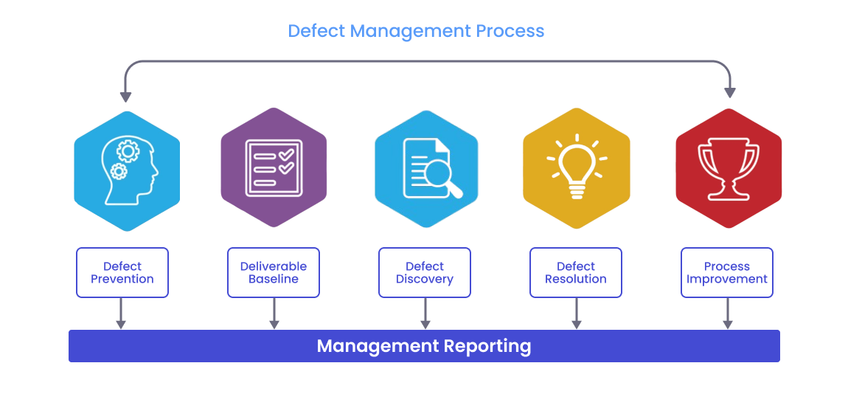
Phases of Defect Management

Slide 5
Phase – Defect Prevention
This phase involves the following steps:
Identify risks: In this step, you find the risks related to the defects that could have a bad impact on the app if left unaddressed or pushed to a later stage.
Estimated impact: In this step, you calculate the impact, or the cost associated with a critical risk found in the app.
Reduce expected impact: In this step, you work on minimizing the potential impact that the discovered risk can cause. You either try to eliminate the risk or reduce its occurrence and the associated impact.

Slide 6
Phase – Deliverable Baseline
A baseline is a formally approved version of a deliverable that serves as a reference point for further development. It signifies that the deliverable has met predefined quality criteria and is ready for the next stage of the project.
Before a deliverable is baselined, errors or issues found are generally considered part of the ongoing development and are not formally logged as defects. Once a deliverable is baselined, any subsequent issues are classified as defects and managed through a defined defect management process.
In the context of defect management, a deliverable baseline is a milestone where a specific version of a product or its component is considered complete and ready for further development work. Once a deliverable is baselined, any further changes to it are subject to change control or configuration management. Defects discovered after a deliverable is baselined are formally logged and tracked as defects, whereas those discovered before are typically addressed as part of the ongoing development process.

Slide 7
Phase – Defect Discovery
Defect identification: Identify the defect before it becomes a major issue
1
Report the defect: Report the identified defect to the development team for a fix
2
Acknowledge: The development team then validates the defect and proceeds to rectify it
3

Slide 8
Phase – Defect Resolution
Allocation: Each bug is allocated to a developer (ideally the one responsible for creating the software). Remember to change the bug status so the entire team knows that a defect is being dealt with. Create a schedule to fix the whole repertoire of defects based on defect priority.
Resolution: As devs work on fixing defects, Test Managers track the process about the schedule above.
Reporting: Test managers receive reports from developers about resolved bugs and update their status on the database by marking them Closed.

Slide 9
Phase – Process Improvement
Corrective and preventive action is taken for process improvement.
All defects identified are considered same as a critical defect.
Minor defects give an opportunity to learn how to improve the process prevent the occurrences of any defect which may impact system failure in the future.
For process improvement, everyone in the project needs to look back and check from where the defect was originated.
Review process which may catch the defects early in the process which are less expensive.

Slide 10
Phase – Defect Management and Reporting
This phase focuses on identifying, recording, tracking, prioritizing, and resolving defects or issues discovered during testing. In this phase, the testing team documents any identified defects, assigns them unique identifiers, and communicates them to the development team for resolution.
This phase involves collaboration between various stakeholders, including testers, developers, project managers, and other team members, as they work together to understand the root cause of each defect, prioritize their resolution based on business impact, and track their progress toward resolution.
When a defect is identified, it should be reported through Manager. The report should include clear descriptions of the symptoms, steps to reproduce the defect, and any relevant context or additional information to help the development team understand the issue and prioritize its resolution.

Slide 11
Defect Report and the States
Defect Report :
A defect report is a document or system entry that records a defect or flaw found in the software application which is causing the normal flow of an application to deviate from its expected behaviour.
It helps developers understand the issue, reproduce it and ultimately fix it.
Defect report elements consists of Defect ID(automatically generated), Title/summary, Description(steps to reproduce), Feature Name, Reproducible defect or not, Status of the defect, Severity and Priority of the defect, Build Version, Environment, Tester Name, Date Raised, Assigned to, Attachments(logs, screenshots), Expected vs. Actual Result.
States of Defect:
Initial State-collect and gather all necessary and essential information that is required to reproduce and resolve defects successfully. Basically, considered as open state or new state.
Returned State- Basically considered as rejected state or clarification state. Developers further ask creator of defect reports to give more information and make required changes in defect reports.
Confirmed State- Basically considered as verified state or resolved state. Testers perform a confirmation test simply to ensure that doe’s defect is resolved successfully or not.

Slide 12
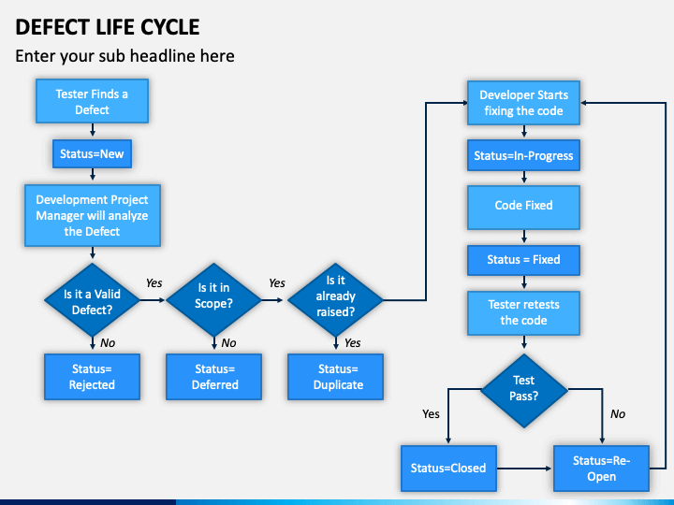
Defect Lifecycle

Slide 13
Defect States Workflow
New : Whenever a defect is identified and posted by tester for first time, it is automatically assigned a status as ‘New’.
Assigned : The defect is then further assigned by test lead to development team. Then it is automatically assigned a status as ‘Assigned’. Now, it’s responsibility of developers to analyse defects and resolve it.
Open : Defect is reviewed and ensured whether the defect identified is valid. If defect is valid then it is automatically assigned a status as ‘Open’.
  Duplicate - If developers during analysis found that defect is posted more than once, or defects reports of both defects have similar results and steps to reproduce, or it corresponds to same concept of defect, then it is automatically assigned a status as ‘Duplicate’.
  Rejected - If developers during analysis found that defect is not genuine or valid then it is automatically assigned a status as ‘Rejected’.
  Deferred/Postponed - If developers during analysis found that defect is not very harmful to system and is not a prime priority and it can be fixed in next release, then is automatically assigned a status as ‘Deferred’.
  Not reproducible - If developers during analysis found that defect is not reproducing by steps that are mentioned in ‘steps to reproduce’ in defect report by test lead, then it is automatically assigned a status as ‘Non-reproducible’.
Fixed : When developers complete the analysis process and found that defect is valid and is needed to be fixed immediately, then developers make changes required to resolve defect. After making changes, developers further verify changes. If no other changes are required to diffuse defect, then it is automatically assigned a status as ‘Fixed’.
Verified : Developers then further pass defect to testing team to verify again, then it is automatically assigned a status as ‘Retest’ i.e. ‘to be verified’. Testers here check if the defect is fixed by developer.
  Reopened - While retesting or verification, if tester found that defect is not fixed completely and it can be reproduced again or it is not fixed correctly, then it is automatically assigned a status as ‘Re-opened’. In this, defect is further re-opened.
Closed : If testing team founds that defect no longer exists and do not find any traces of defect being able to reproduce again, then it is automatically assigned a status as ‘Closed’.

Slide 14
Benefits of Defect Lifecycle
Increased Visibility: A defect life cycle gives transparency into the current status of all open defects. Everyone knows if an issue is still being diagnosed, assigned to a developer, waiting to be tested or closed out.
Accountability: Assigning a defect to an owner and tracking it through to resolution ensures that it does not fall through the cracks. This accountability helps drive faster defect turnaround times.
Continuous Improvement: Analyzing defect metrics like open defect counts, aging and closure rates helps uncover problem areas. Teams can then focus process improvements on areas that will have the biggest quality impact.
Higher Customer Satisfaction: Fixing defects faster and with fewer regressions means customers are more likely to have a positive experience, thus boosting satisfaction and retention.

Slide 15
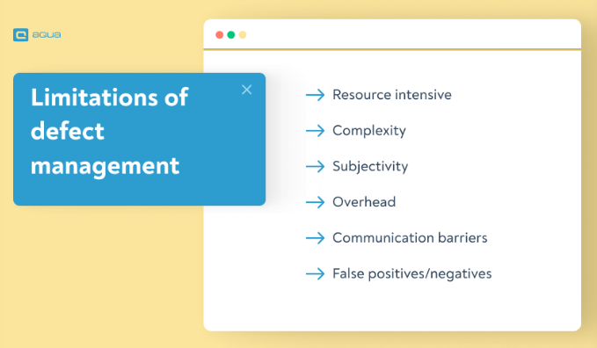
Limitations in Defect Lifecycle

Slide 16
Limitations in Defect Lifecycle
The following are the limitations you might face while trying to organise perfect defect management:
Resource intensive: Maintaining a thorough process requires resources, including time, tools, and personnel, which generally divert attention from other activities.
Complexity: As software projects become more intricate, managing defects becomes complex and challenging, especially when dealing with interconnected systems.
Subjectivity: Determining the severity and impact of defects are sometimes subjective, potentially creating differences in prioritisation among team members.
Overhead: If not managed effectively, defect management processes can introduce administrative overhead, with massive delays and reduced efficiency.
Communication barriers: In larger teams or distributed environments, effective communication between team members is challenging, which can lead to mismanagement of defects.
False positives/negatives: Automated defect tools in software testing may produce false positives or negatives, requiring manual intervention for accurate assessment.
Limited Visibility into User Environment: Defect management processes often lack visibility into the diverse user environments where software products are deployed. Variations in hardware, operating systems, or network configurations may result in defects that are challenging to reproduce and address effectively, leading to discrepancies between reported issues and their resolution.
Resistance to Change: Implementing new defect management processes or tools may face resistance from team members accustomed to existing workflows. Resistance to change can hinder adoption rates and compromise the effectiveness of defect management initiatives, delaying improvements in software quality and project timelines.

Slide 17
Manage defects effectively
Effective defect management involves:
Bug tracking
Root cause analysis
Collaboration among development teams
Implementing corrective measures
Clear and consistent documentation
Prioritization and severity classification
Ownership and accountability
Identifying possible defects in the software
Reviewing issues thoroughly and analyzing them to come up with a defect report

Slide 18

Q & A

Slide 19


