Slide 1


From Non-Tech to QA Lead:
My Journey into Software Testing
Navigating QA - Excelling in Software Testing Without a Traditional IT Background.
Presented by: Korkor Mensah, QA Manager, eProcess International - Ecobank Group | Speaker @ National Software Testing Conference, London | 22nd July 2025.
by Korkor Mensah

Slide 2
Agenda
My Journey into Technology
Personal background and transitional challenges.
Debunking QA Myths
Embracing Diversity in QA.
Bridging the Skills Gap
Practical steps and transferable skills.
Establishing Credibility and Earning Trust
From Tester to Trusted QA Advocate.
Empowering Leadership through Empathy and Growth
Leadership lessons from the trenches.
Final Reflections and Takeaways
Advice for your own QA journey.

Slide 3
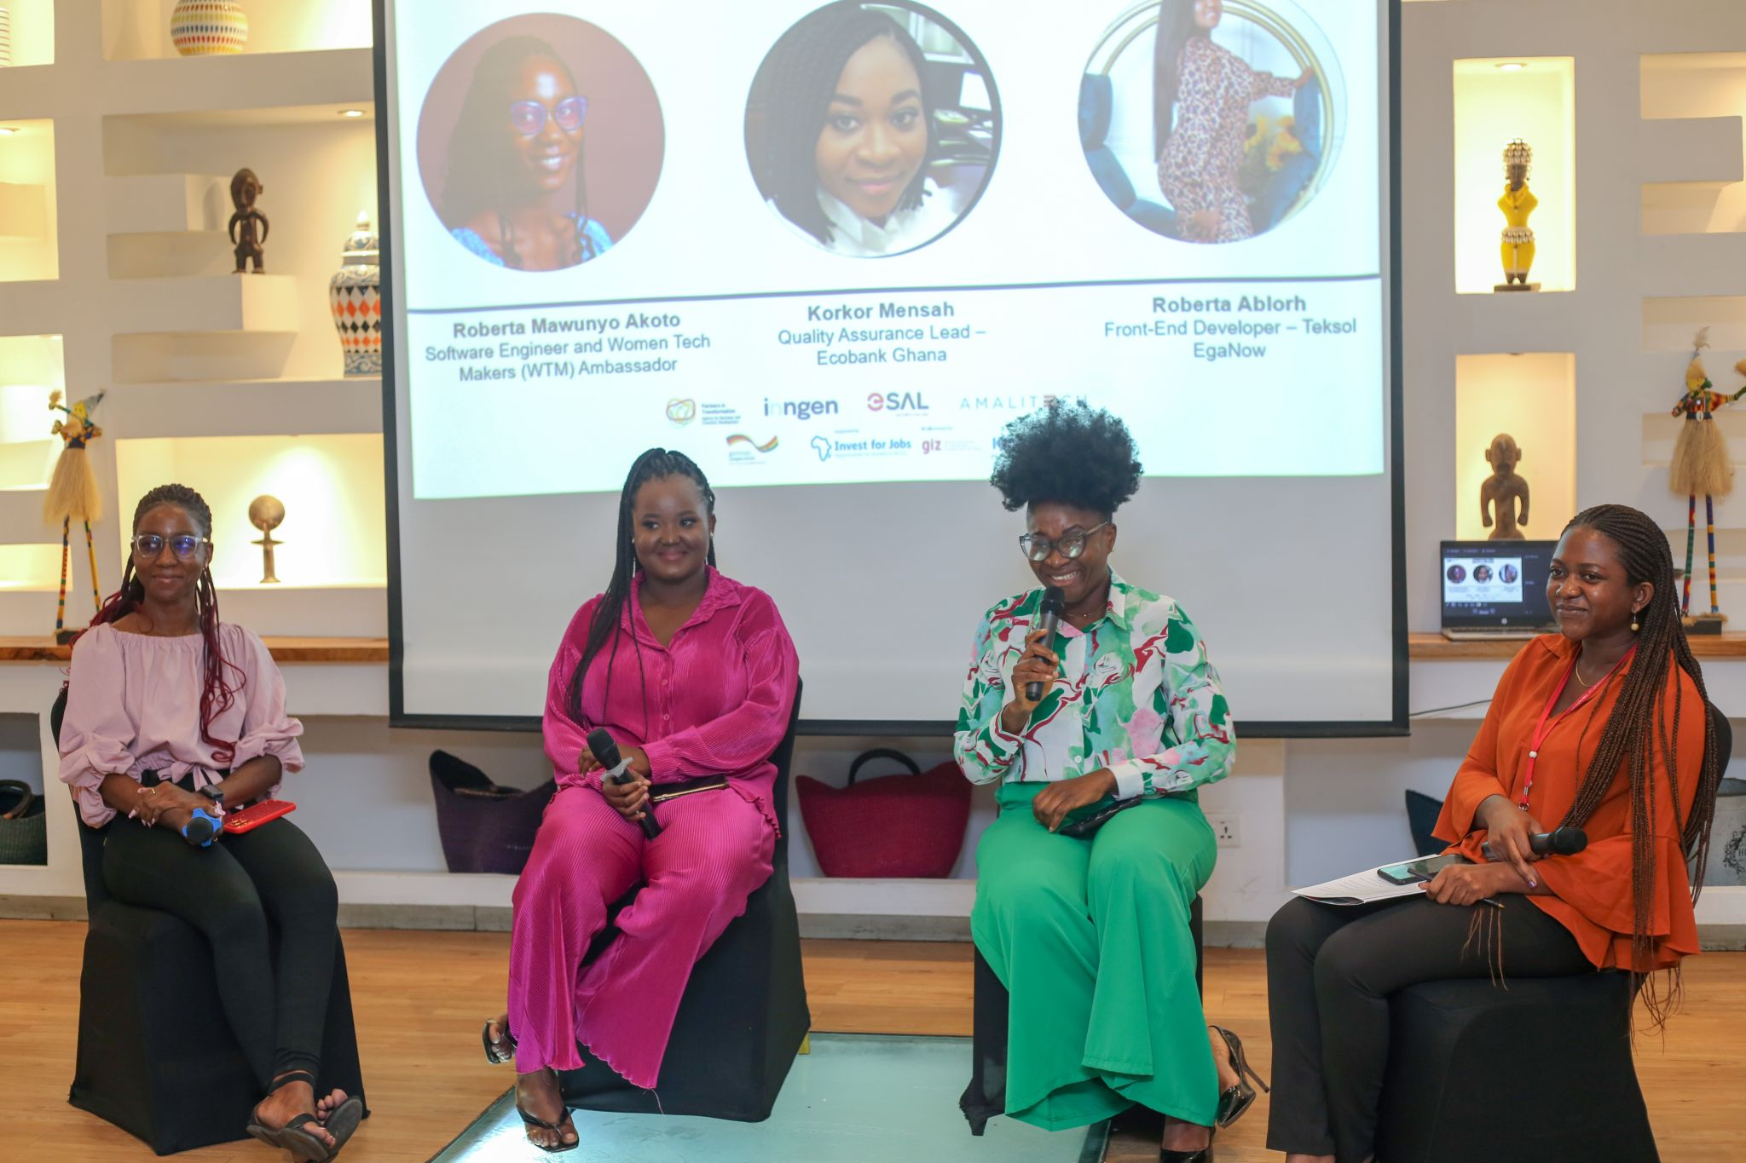

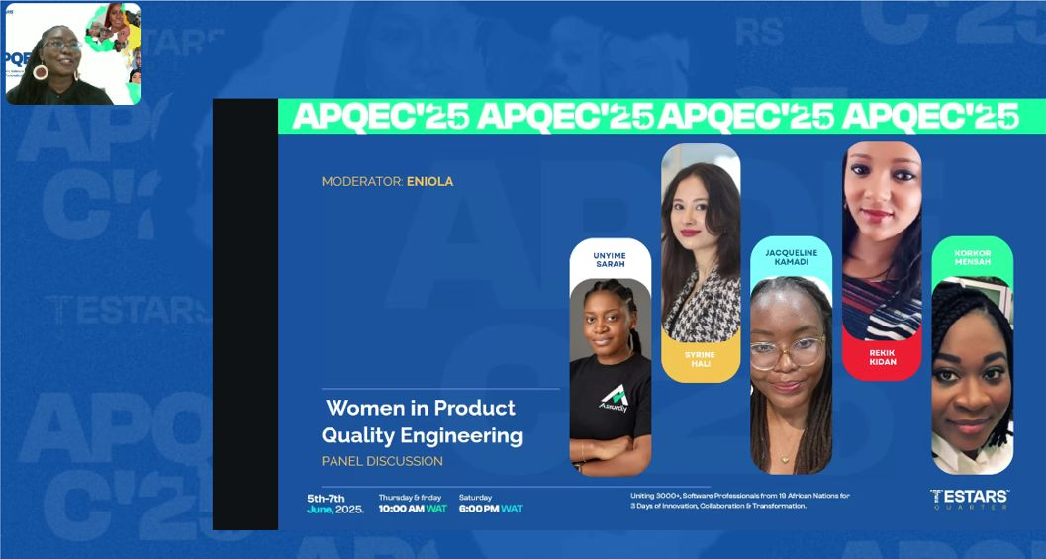

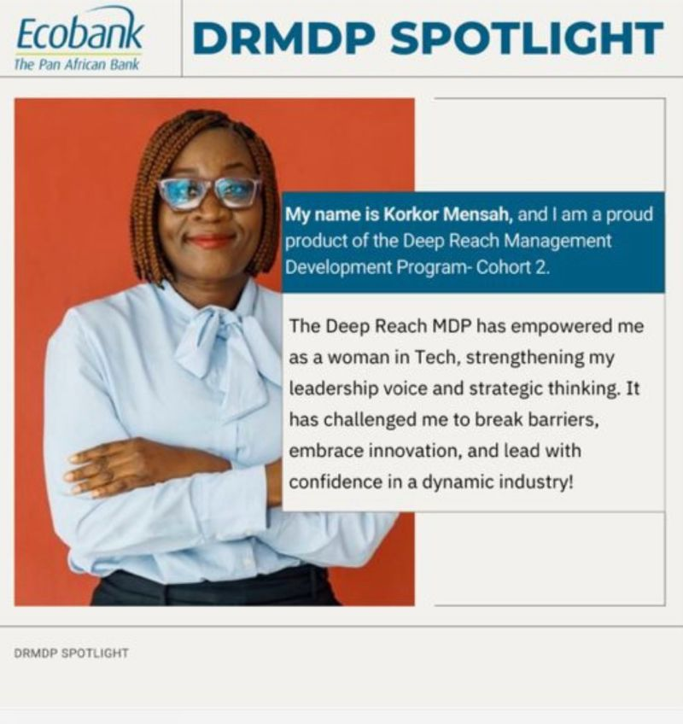
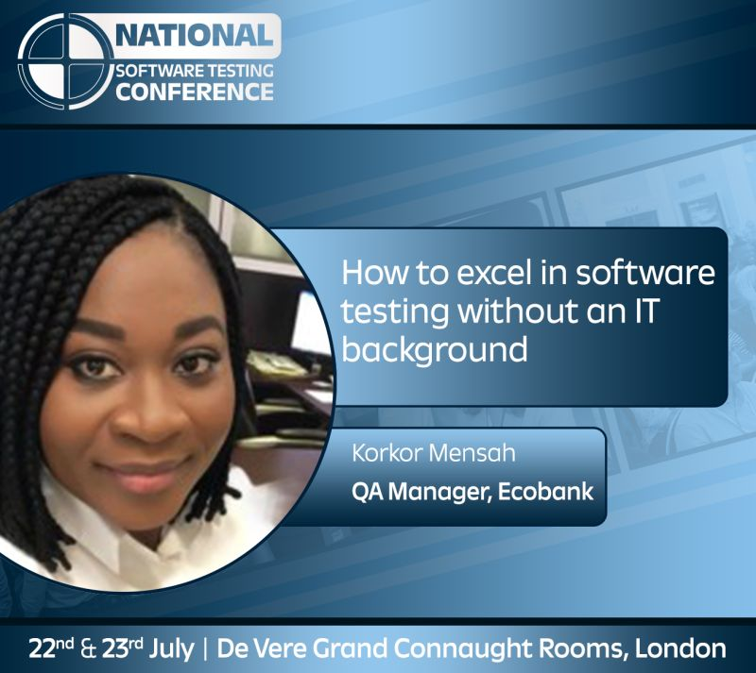
TECH JOURNEY
My Inspiring Journey
Into Technology

Slide 4




Q1 2018
Career Turning Point
Discovered my passion for QA.
2019-2023
Self-Learning Initiatives
Non-Traditional Journey to Quality Assurance Excellence
Utilized Udemy, LinkedIn Learning, and YouTube.
2019 - 2022
Facing Stereotypes
Challenged 'just testing' stereotypes.
2022 - 2024
ISTQB Certification
Earned the ISTQB Foundation Certificate.
2023
Building Confidence
Gained structure, confidence, and direction.
2024
Leadership Transition
Transitioned to leadership roles in QA.

Slide 5

Debunking the Myths & Embracing Diversity in QA
The reality?
QA needs diverse perspectives and skills beyond just technical knowledge.

Slide 6

Breaking Myths in QA: Skills Over Degrees
40%
87%
Diverse paths lead to QA careers.
Skills are prioritized by employers.
40% of today's QA professionals come from non-traditional backgrounds, showcasing that diverse experiences contribute significantly to the field.
According to LinkedIn (2023), 87% of employers prioritize skills over degrees, emphasizing the importance of relevant experience in hiring.
1M+
ISTQB certification highlights accessibility
There are 1 million+ ISTQB certified testers worldwide, demonstrating the accessibility of the QA profession and its welcoming nature.
Sources: https://survey.stackoverflow.co/2023/
LinkedIn: https://learning.linkedin.com/resources/workplace-learning-report
ISTQB® Official Website – https://www.istqb.org/

Slide 7

Bridging the Skills Gap: Practical Steps Into QA
The path to QA excellence isn't about where you start—it's about your willingness to learn and adapt.

Slide 8
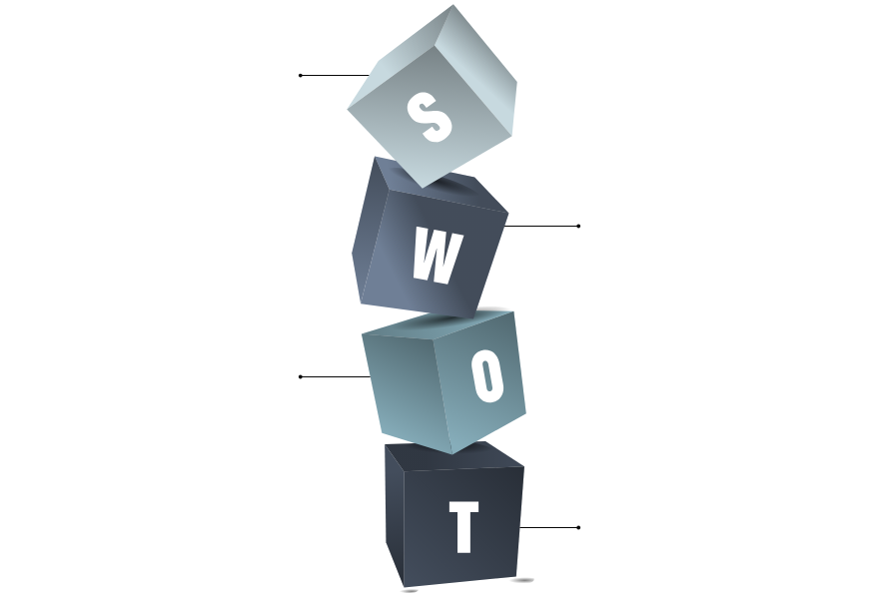




Building a Strong QA Foundation Without IT Training
Strengths
1
Communication and problem-solving skills.
2
Weaknesses
2
Limited hands-on experience in IT.
Opportunities
3
Volunteering for complex projects to gain skills.
Threats
4
Lack of formal IT training may hinder progress.

Slide 9
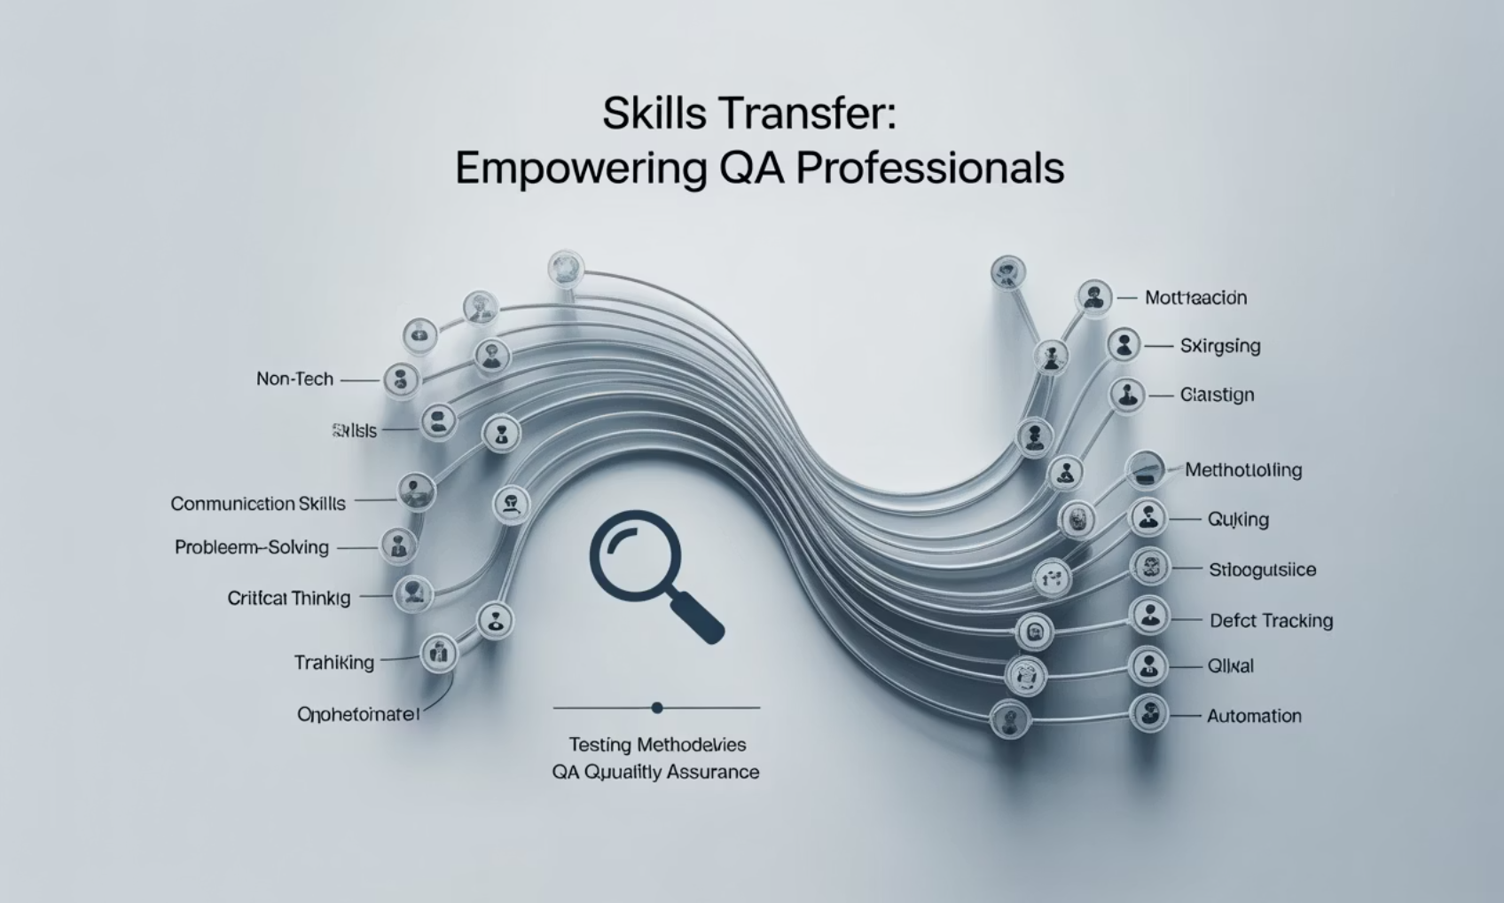
Building My QA Foundation
Transferable Skills That Matter
Overcoming Technical Hurdles
Challenge: No IT training
Challenge: Limited hands-on experience
Solution: Consistent daily learning and a supportive manager
Solution: Shadowing developers and QA Lead
Solution: Volunteering for complex projects
Communication skills
Time management
Problem-solving abilities
Stakeholder management

Slide 10

Establishing Credibility and Earning Trust

Slide 11

From Tester to Trusted QA Advocate
Gaining Credibility
Applying knowledge practically
Clear documentation and communication
Advocates for QA throughout product lifecycle
Demonstrated Value Through:
Significant reduction in production bugs
Improved test coverage metrics
Accelerated release cycles
Speaking on the Big Stage
Honored to share my journey at the National Software Testing Conference, empowering others from non-tech backgrounds.

Slide 12


Leadership in QA isn't about being the most technical person in the room. It's about vision, empathy, and creating an environment where quality can thrive.

Slide 13

Empowering Leadership through Empathy
and Growth
QA Manager at eProcess International – Ecobank Group
Leading a diverse QA team of 7 testers.
Investing in team development
Creating a safe learning environment
Advocating for quality across the organization

Slide 14

Final Reflections & Takeaways
Final Thoughts
Your unique journey matters in tech.
Non-tech backgrounds enrich QA roles.
QA is about quality, communication, and collaboration
Soft skills are vital in QA success
Key Takeaways for Aspiring QA Professionals
Be Curious: Ask questions, explore systems
Get Certified: ISTQB is an excellent start
Be Hands-On: Begin with manual testing
Leverage Strengths: Soft skills are powerful
Be Visible: Write blogs, attend meetups

Slide 15



Let’s connect and enhance the tech landscape together
Let's Connect
Korkor Mensah, MBA, ITILv4, PMP, ISTQB | LinkedIn
Breaking Barriers Together
Let's continue making technology more inclusive and diverse.
Thank you for joining me today!

