Slide 1
Lean Six Sigma in Action
Driving Quality and Efficiency in Testing

Slide 2

Who am I ?
Bharathi Sudanagunta
Test Manager @ MHRA
Over a decade of experience in Software Testing, Quality Assurance and Test Management
Been part of Startup Organisations leading all my way up to Civil Services
Key areas of Expertise such as Test Management, Team Leadership, Culture Building
Certifications (relevant for today) : ISTQB Advanced Test Manager, Lean Six Sigma Green belt(p), ISO 9001, ITIL 4
Achievements : Leadership in Action Award, Team leader of the year (Nominated)
Volunteer : British Gymnastics (BG) Trampoline Judge; Parent Governor

Slide 3
Why Do We Keep Testing… Without Improving?
How many of you feel like you're constantly testing but never improving how you test?
Think about your last sprint or release cycle.
Were you firefighting defects? Repeating slow regression runs?
Did testing feel like a blocker or an enabler?

Slide 4
Why Process Improvement in Testing?
Lean
= Efficiency
Six sigma
= Effectiveness
Process Improvements
- Testing is a Process

Slide 5
Morning Routine – A Fun Analogy
Since you got up from bed and opened the door to come to this conference this morning… how many inefficiencies did you experience?
Did you walk back and forth between rooms looking for something?
Open and close the wardrobe multiple times trying to decide what to wear?
Wait around while your tea or coffee brewed?
Did you take your dog for a walk that disrupted your flow?
Did you struggle with too many choices — breakfast, coats, shoes?
Did breakfast or getting the kids ready involve extra steps or confusion?
Did you forget something—like a lunch box, bag, or keys—and go back for it?
Did you double-check your bag or plans, even after you were ready to go?
Lean’s 7 types of waste - TIMWOOD

Slide 6
TIMWOOD – 7 types of waste in Lean
Lean helps us ask the right questions: What truly adds value? Where are the delays? And how do we design testing to flow smoothly, with no waste!
Transport: Walking back and forth between rooms (e.g., bedroom to kitchen to kids’ room) –switching or constantly navigating between systems to get data or tools.
Now think about your last regression run — how many of these wastes can you spot?
Inventory: Too many choices: breakfast items, wardrobe options, keys, coats - too many test cases, too many environments, or too much duplicated data.
Motion: Repeatedly opening and closing cupboards to decide on what breakfast to serve for kids; make up; shoelaces- repeatedly setting up tests manually when it could be automated
Waiting: Standing idle while the tea brews or waiting for the kids to finish their breakfast – or waiting for mascara to dry or make up to set -the environment to spin up
Over Production: Making extra food “just in case” or setting out more clothes/items than actually needed -running more test scenarios than we actually need or creating artefacts no one uses
Over Processing: Double-checking - water bottles or bags , keys, doors - unnecessarily after already ensuring they’re ready. doing the same checks manually and via automation, or repeating work due to unclear definitions.
Defects: Forgetting an item (e.g.,lunch , ID’s, school diary) and having to rush back to prepare or find it before you leave. -bugs caught late or missed requirements.

Slide 7
Lean Principles
Define Value
What matters to the customer (e.g. fast, reliable, bug-free releases)?
Map the Value Stream
What steps in your testing add value vs. waste?
Make Value Flow
Avoid blockers (e.g. flaky tests, redundant steps)
Pull, Don’t Push
Let customer/user needs drive testing, not a checklist mentality
Seek Perfection
Continuously improve testing processes

Slide 8

3 Japanese M’s
Muda – Waste
(e.g. repetitive manual tests)
Muri – Overburden
(e.g. unrealistic timelines, overloaded testers)
Mura – Unevenness
(e.g. inconsistent test velocity between sprints)
Adapted from Lean Thinking – Womack & Jones (1996)
3M’s: Toyota Production System

Slide 9
Six Sigma – The Effectiveness Side
Philosophy – Prevent problems, don’t fix them
Organisation – Structured roles
Metrics – Defect rate, test failure %
Tools – Control charts, histograms, Pareto
Process Improvement + Change Management

Slide 10
DMAIC - The Core of Lean Six Sigma
D- Define
M- Measure
A - Analyse
I - Improve
C - Control
Clearly state the problem and what success looks like
(E.g. long test cycle time, too many escaped defects)
Gather data to understand the current state
(How long are cycles? How many defects? What’s failing?)
Use data to find root causes
(e.g. flaky automation, redundant tests, unclear requirements)
Design and test solutions
(Script modularisation, smarter waits, test environment tweaks)
Sustain gains through monitoring and standardisation
(Dashboards, checklists, automation triggers)

Slide 11
DMAIC in Action – Real Testing Improvement
Define
Nightly regression runs were too long and had high failure rates, slowing down releases.
Measure
Tracked using Allure and Jira
Analyse
Improve
Control
Test cycle time
Common failure points
% of flaky tests
Repeated login steps in each test
Static waits causing timeouts
Fragile XPaths causing instability
Modularised login
Replaced static waits with dynamic waits
Switched to stable selectors
Introduced a script design checklist
Created a pass/fail dashboard
Monthly review process to sustain improvements
Result: Regression time reduced by 40%, flakiness dropped by 25%. That’s the power of DMAIC in action

Slide 12
Benefits Achieved – Real Impact from Lean Six Sigma
🚀 Faster test cycles – Regression suite execution time reduced by 40%
🛡️ Fewer defects – Flaky tests dropped by 25%
🤝 Greater team ownership – Testers now lead quality improvements, not just test execution
✅ Improved confidence in releases – Cleaner pipelines, faster sign-offs

Slide 13
Let’s Redefine Testing with Lean Six Sigma
Don’t just test better - test smarter
Bring structure to your improvement, not just your scripts
Small steps + right tools = big impact

Slide 14

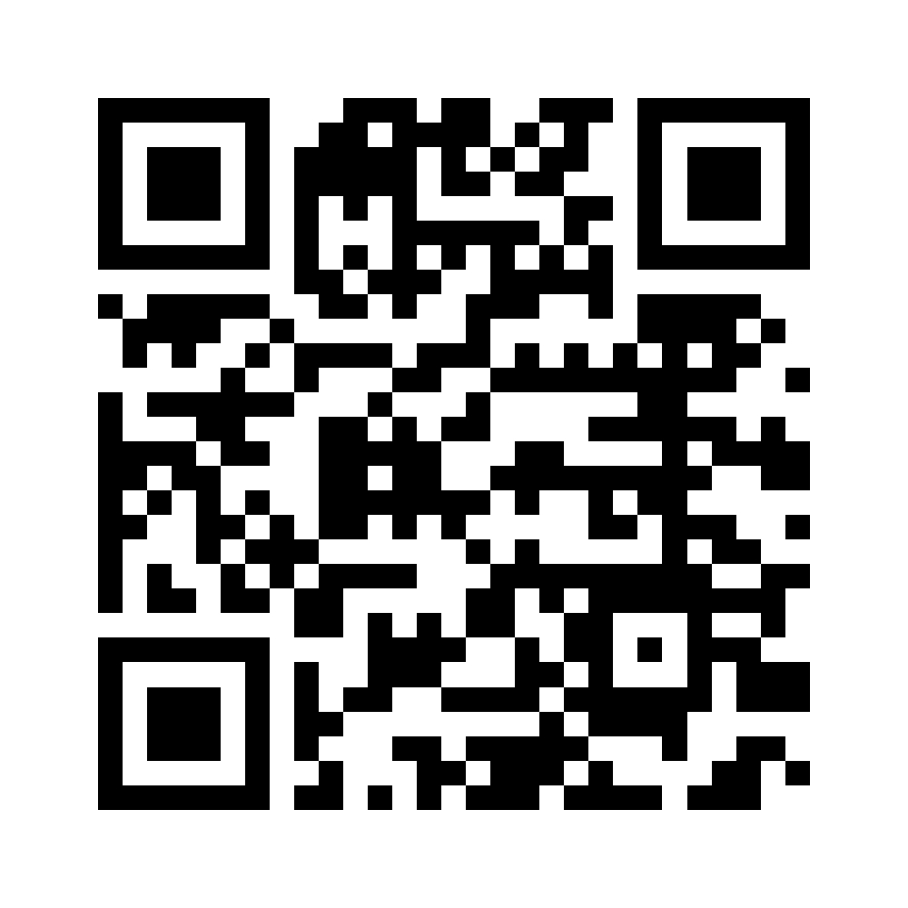
Now think about one inefficiency in your testing process…
What would it take to fix it using DMAIC?
Thankyou !!!
LinkedIn – Bharathi S

Slide 15

References
Lean Thinking – Womack & Jones (1996)
Toyota Production System – Muda, Muri, Mura
DMAIC Framework – Six Sigma (Motorola, 1980s)
7 Wastes (TIMWOOD) – Lean Manufacturing Tools

